Slide 1

History of HTML
Introduction to Frontend Web Design
Notes:
# History of HTML
So we’ve talked a little bit about the structure of HTML and what it is. So let’s talk about the history. This is not going to be on the test. Because there’s no test.
### Slide Transition
HTML was invented by scientists at CERN based off of SGML (standard generalized markup language). It was originally used to link Physics documents together.
### Slide Transition
However Hyper Text as a concept had existed since the 40s. I’m not sure how they linked things back then, I imagine with pneumatic tubes.
### Slide Transition
Apple took Hyper Text in the 80s and invented the concept of hyper cards, which allowed them to create navigation buttons that took you to places when you clicked on them.
### Slide Transition
So then a lot of different programmers decided that they had a better way of doing HTML and that everyone should do their way. So as you often have with many programmers, you had a lot of competing standards. Eventually they all sat down in a room and standardized it all and created HTTP
### Slide Transition
HTTP stands for Hyper Text Transfer Protocol, and it was created as a standard way of transmitting HTML documents. If you’ve ever heard that you’re making a request to a server or receiving a response from a server, it’s an HTTP request and an HTTP response. In short HTTP defines standardized requests and responses to communicate between machines
### Slide Transition
So in 1991 due to demand of use for HTML, they added a few more features that everyone wanted and dubbed it HTML+
### Slide Transition
In 1992 the national center for supercomputing applications (NCSA) connects to CERN and downloads two web browsers. They’re so bad they decide to write their own called Mosaic
### Slide Transition
Later in 92 images get added to HTML thus starting the explosive popularity of people sharing cat photos
### Slide Transition
In 1993, Lynx came out, and promptly ignored the fact that images had been added to web browsers, opting to stick with text only.
### Slide Transition
In April of 93 Mosaic was released for Sun Microsystems. It is poorly designed and full of random features.
### Slide Transition
In fact it’s so bad that in 94 they formed a committee called the Internet Engineering Task Force, presumably to fight crime or something because it has the words task force in it and creates a bunch of groups about security, network routing, and applications. It also believed that the Web and the Internet belonged to the people.
### Slide Transition
Then there were a lot of parties.
### Slide Transition
In 94, HTML 2 specs were released. They decided to eschew the + naming scheme after this.
### Slide Transition
Also in 94, Netscape was formed with a browser you may remember as Netscape Navigator. Since the browser was so popular, they decided to break the standard that was literally just created and make their own stuff.
### Slide Transition
So later in 94, A second organization is formed called the World Wide Web Consortium (or W3C) sponsored by companies who hated what Netscape was doing. Actually they wanted to standardize the web.
### Slide Transition
Lots of new tags were added to HTML in 95. Academics hated it because it added stuff that was extraneous and they wanted the kids to get off their lawn.
### Slide Transition
In march of 95, HTML3 is published and its standards are promptly adopted and then ignored as more web browsers started adding their own shit. In fact tables were actually added by the Navy and we have them to thank for the absolutely terrible formatting we all saw throughout the 90s.
### Slide Transition
In August of 95, IE 1 is released. It promptly is replaced by IE 2 in Nov. of 95.
### Slide Transition
In Sept of 95, Netscape proposes frames, cementing themselves as people we now hate forever. They also create Javascript, which doesn’t help their case.
### Slide Transition
Luckily in Nov of 95, a bunch of vendors came together and decided they want to standardize HTML further. Stylesheets come into existence.
### Slide Transition
In Dec of 95, just one year after coming together with an awesome name, the IETF disbands.
### Slide Transition
In April of 96, Javascript gets added to the HTML standard.
### Slide Transition
In July of 96, Microsoft seems more interested in open standards. They release IE for windows 3.1 and macs. Then someone decides to play a practical joke and adds Marquee and Blink to the HTML 3 standards.
### Slide Transition
Jan of 97 marks the passage of HTML 3.2, which is actually all of HTML 1 + 2 + 3. It also marked the creation of the different flows of HTML for layout, which we will talk about when we get to CSS.
### Slide Transition
In Dec of 97, they released HTML 4 because HTML 3.2 still had netscape stuff in it. Then everything has been stable for about 10 years.
### Slide Transition
In January 2008, the HTML 5 draft got published. In May 2011, last call for changes.
1. More exercises

Slide 2
Contents
History of HTML
Q&A
Exercises
Notes:
# History of HTML
So we’ve talked a little bit about the structure of HTML and what it is. So let’s talk about the history. This is not going to be on the test. Because there’s no test.
### Slide Transition
HTML was invented by scientists at CERN based off of SGML (standard generalized markup language). It was originally used to link Physics documents together.
### Slide Transition
However Hyper Text as a concept had existed since the 40s. I’m not sure how they linked things back then, I imagine with pneumatic tubes.
### Slide Transition
Apple took Hyper Text in the 80s and invented the concept of hyper cards, which allowed them to create navigation buttons that took you to places when you clicked on them.
### Slide Transition
So then a lot of different programmers decided that they had a better way of doing HTML and that everyone should do their way. So as you often have with many programmers, you had a lot of competing standards. Eventually they all sat down in a room and standardized it all and created HTTP
### Slide Transition
HTTP stands for Hyper Text Transfer Protocol, and it was created as a standard way of transmitting HTML documents. If you’ve ever heard that you’re making a request to a server or receiving a response from a server, it’s an HTTP request and an HTTP response. In short HTTP defines standardized requests and responses to communicate between machines
### Slide Transition
So in 1991 due to demand of use for HTML, they added a few more features that everyone wanted and dubbed it HTML+
### Slide Transition
In 1992 the national center for supercomputing applications (NCSA) connects to CERN and downloads two web browsers. They’re so bad they decide to write their own called Mosaic
### Slide Transition
Later in 92 images get added to HTML thus starting the explosive popularity of people sharing cat photos
### Slide Transition
In 1993, Lynx came out, and promptly ignored the fact that images had been added to web browsers, opting to stick with text only.
### Slide Transition
In April of 93 Mosaic was released for Sun Microsystems. It is poorly designed and full of random features.
### Slide Transition
In fact it’s so bad that in 94 they formed a committee called the Internet Engineering Task Force, presumably to fight crime or something because it has the words task force in it and creates a bunch of groups about security, network routing, and applications. It also believed that the Web and the Internet belonged to the people.
### Slide Transition
Then there were a lot of parties.
### Slide Transition
In 94, HTML 2 specs were released. They decided to eschew the + naming scheme after this.
### Slide Transition
Also in 94, Netscape was formed with a browser you may remember as Netscape Navigator. Since the browser was so popular, they decided to break the standard that was literally just created and make their own stuff.
### Slide Transition
So later in 94, A second organization is formed called the World Wide Web Consortium (or W3C) sponsored by companies who hated what Netscape was doing. Actually they wanted to standardize the web.
### Slide Transition
Lots of new tags were added to HTML in 95. Academics hated it because it added stuff that was extraneous and they wanted the kids to get off their lawn.
### Slide Transition
In march of 95, HTML3 is published and its standards are promptly adopted and then ignored as more web browsers started adding their own shit. In fact tables were actually added by the Navy and we have them to thank for the absolutely terrible formatting we all saw throughout the 90s.
### Slide Transition
In August of 95, IE 1 is released. It promptly is replaced by IE 2 in Nov. of 95.
### Slide Transition
In Sept of 95, Netscape proposes frames, cementing themselves as people we now hate forever. They also create Javascript, which doesn’t help their case.
### Slide Transition
Luckily in Nov of 95, a bunch of vendors came together and decided they want to standardize HTML further. Stylesheets come into existence.
### Slide Transition
In Dec of 95, just one year after coming together with an awesome name, the IETF disbands.
### Slide Transition
In April of 96, Javascript gets added to the HTML standard.
### Slide Transition
In July of 96, Microsoft seems more interested in open standards. They release IE for windows 3.1 and macs. Then someone decides to play a practical joke and adds Marquee and Blink to the HTML 3 standards.
### Slide Transition
Jan of 97 marks the passage of HTML 3.2, which is actually all of HTML 1 + 2 + 3. It also marked the creation of the different flows of HTML for layout, which we will talk about when we get to CSS.
### Slide Transition
In Dec of 97, they released HTML 4 because HTML 3.2 still had netscape stuff in it. Then everything has been stable for about 10 years.
### Slide Transition
In January 2008, the HTML 5 draft got published. In May 2011, last call for changes.
1. More exercises

Slide 3

Humble Beginnings - 1989
Notes:
HTML was invented by scientists at CERN based off of SGML (standard generalized markup language). It was originally used to link Physics documents together.

Slide 4
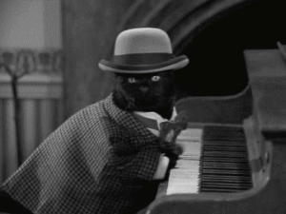
But actually back in the 40s Hyper Text Existed
Notes:
However Hyper Text as a concept had existed since the 40s. I’m not sure how they linked things back then, I imagine with pneumatic tubes.

Slide 5

Apple Creates Hyper Cards in the 80s
Notes:
Apple took Hyper Text in the 80s and invented the concept of hyper cards, which allowed them to create navigation buttons that took you to places when you clicked on them.

Slide 6
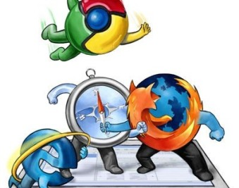
War Starts
Notes:
So then a lot of different programmers decided that they had a better way of doing HTML and that everyone should do their way. So as you often have with many programmers, you had a lot of competing standards. Eventually they all sat down in a room and standardized it all and created HTTP

Slide 7
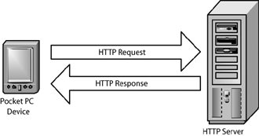
A savior is created
Notes:
HTTP stands for Hyper Text Transfer Protocol, and it was created as a standard way of transmitting HTML documents. If you’ve ever heard that you’re making a request to a server or receiving a response from a server, it’s an HTTP request and an HTTP response. In short HTTP defines standardized requests and responses to communicate between machines

Slide 8
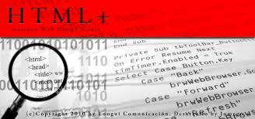
91 bring changes
Notes:
So in 1991 due to demand of use for HTML, they added a few more features that everyone wanted and dubbed it HTML+

Slide 9

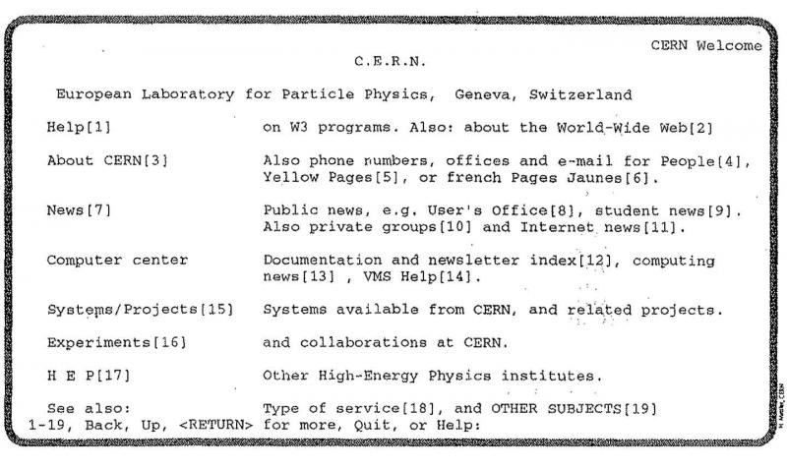
1992
Notes:
In 1992 the national center for supercomputing applications (NCSA) connects to CERN and downloads two web browsers. They’re so bad they decide to write their own called Mosaic

Slide 10
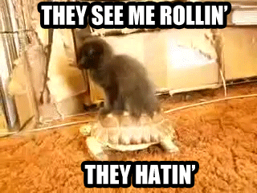
Later in 92
Notes:
Later in 92 images get added to HTML thus starting the explosive popularity of people sharing cat photos

Slide 11
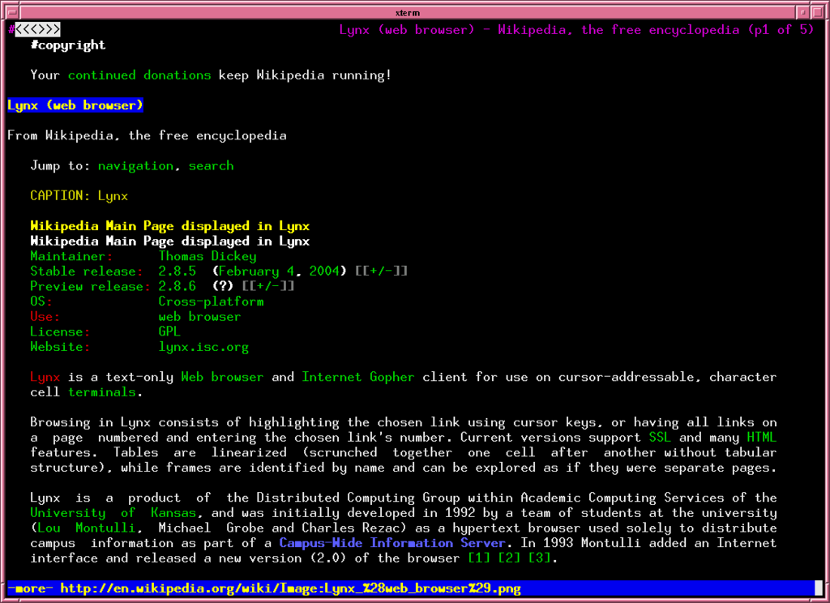

1993, Lynx is released
Notes:
In 1993, Lynx came out, and promptly ignored the fact that images had been added to web browsers, opting to stick with text only.

Slide 12
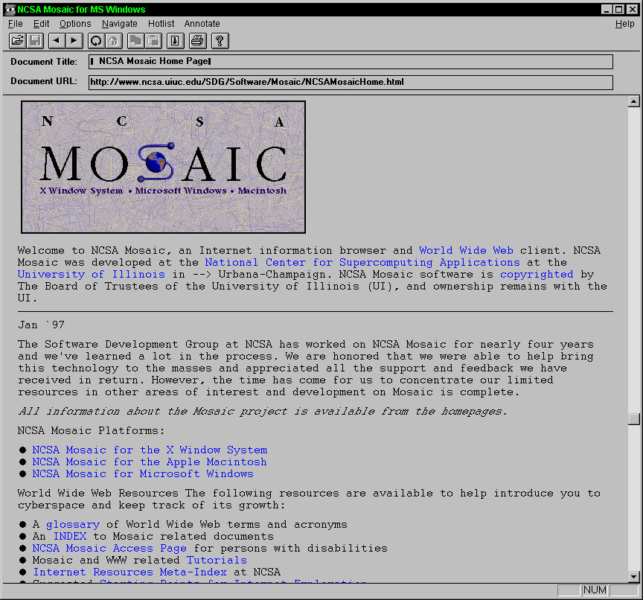

April of 93, Mosaic finally released
Notes:
In April of 93 Mosaic was released for Sun Microsystems. It is poorly designed and full of random features.
### Slide Transition

Slide 13

In Response the IETF is formed
Notes:
In fact it’s so bad that in 94 they formed a committee called the Internet Engineering Task Force, presumably to fight crime or something because it has the words task force in it and creates a bunch of groups about security, network routing, and applications. It also believed that the Web and the Internet belonged to the people.

Slide 14

There were a lot of parties
Notes:
Then there were a lot of parties.

Slide 15
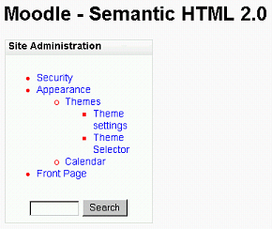
1994, HTML 2 released
Notes:
In 94, HTML 2 specs were released. They decided to eschew the + naming scheme after this.

Slide 16
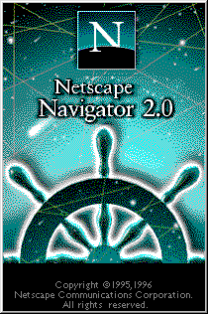

1994, Netscape released a browser
Notes:
Also in 94, Netscape was formed with a browser you may remember as Netscape Navigator. Since the browser was so popular, they decided to break the standard that was literally just created and make their own stuff.

Slide 17

In Response, the W3C was formed
Notes:
So later in 94, A second organization is formed called the World Wide Web Consortium (or W3C) sponsored by companies who hated what Netscape was doing. Actually they wanted to standardize the web.

Slide 18
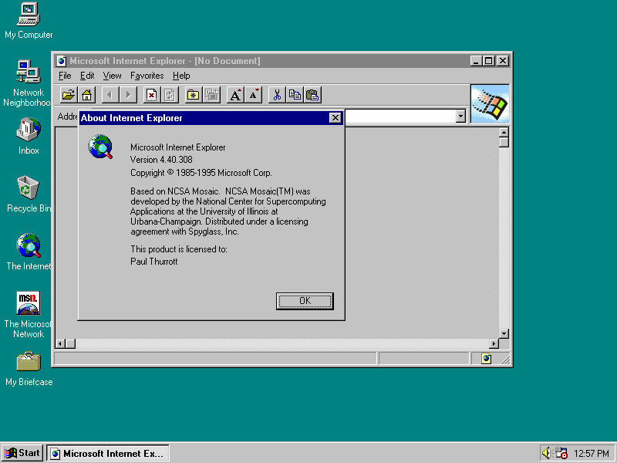
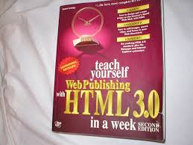

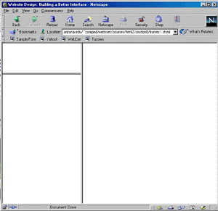

95 was a big year
Notes:
Lots of new tags were added to HTML in 95. Academics hated it because it added stuff that was extraneous and they wanted the kids to get off their lawn.
### Slide Transition
In march of 95, HTML3 is published and its standards are promptly adopted and then ignored as more web browsers started adding their own shit. In fact tables were actually added by the Navy and we have them to thank for the absolutely terrible formatting we all saw throughout the 90s.
### Slide Transition
In August of 95, IE 1 is released. It promptly is replaced by IE 2 in Nov. of 95.
### Slide Transition
In Sept of 95, Netscape proposes frames, cementing themselves as people we now hate forever. They also create Javascript, which doesn’t help their case.
### Slide Transition
Luckily in Nov of 95, a bunch of vendors came together and decided they want to standardize HTML further. Stylesheets come into existence.
### Slide Transition
In Dec of 95, just one year after coming together with an awesome name, the IETF disbands.

Slide 19

April 96, JS becomes standard
Notes:
In April of 96, Javascript gets added to the HTML standard.

Slide 20
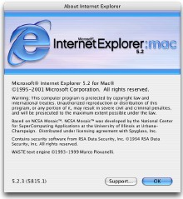
July 96, MS plays by the rules
Notes:
### Slide Transition
Jan of 97 marks the passage of HTML 3.2, which is actually all of HTML 1 + 2 + 3. It also marked the creation of the different flows of HTML for layout, which we will talk about when we get to CSS.

Slide 21
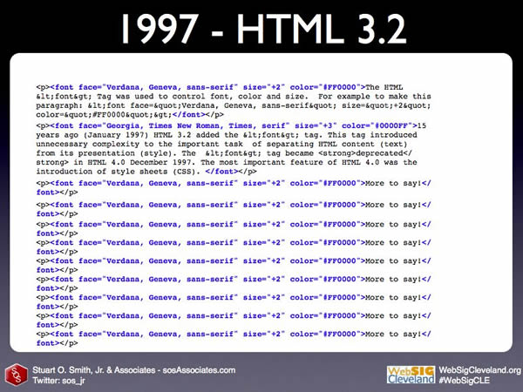
July 97, HTML 3.2 is released
Notes:
Jan of 97 marks the passage of HTML 3.2, which is actually all of HTML 1 + 2 + 3. It also marked the creation of the different flows of HTML for layout, which we will talk about when we get to CSS.

Slide 22
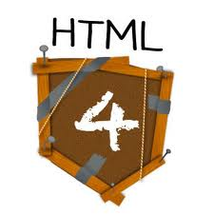
December 97, HTML 4 released
Notes:
n Dec of 97, they released HTML 4 because HTML 3.2 still had netscape stuff in it. Then everything has been stable for about 10 years.

Slide 23

August 2006, jQuery is released: makes Javascript usable
Notes:
Jquery gets published in 2006. Finally making jS usable

Slide 24
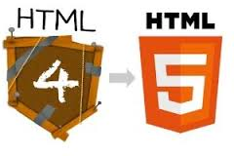
2008-Present: HTML 5?
Notes:
In January 2008, the HTML 5 draft got published. In May 2011, last call for changes.

Slide 25
Q&A

